Slide 1





Basics of Data Analysis
1st i-School and Conference on Metric-Affine Gravity
David Benisty

Slide 2
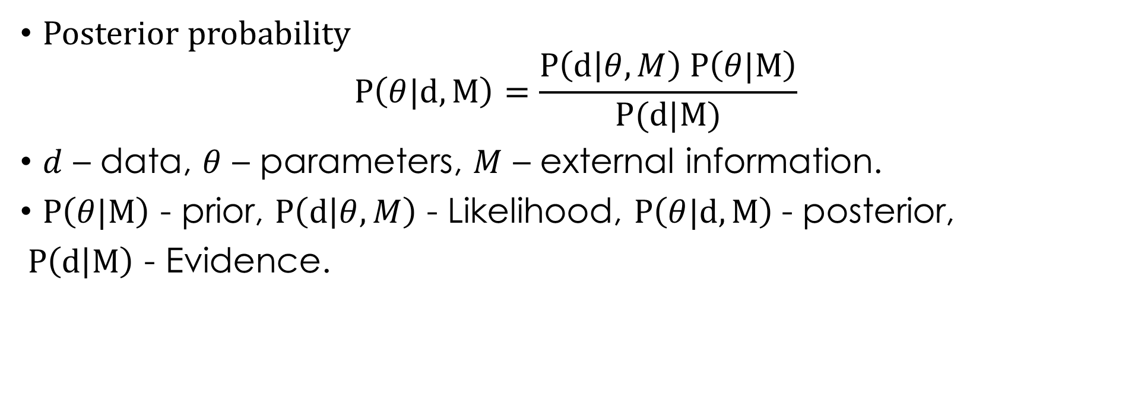
Bayes Theorem
Posterior probability
$$P\left(θ|d,M\right)=\frac{P\left(d | θ,M\right) P\left(θ|M\right)}{P(d|M)}$$
$d$ – data, $θ$ – parameters, $M$ – external information.
$P\left(θ|M\right)$ - prior, $P\left(d | θ,M\right)$ - Likelihood, $P\left(θ|d,M\right)$- posterior,
$P\left(d | M\right)$ - Evidence.

Slide 3
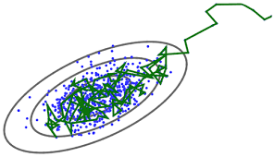
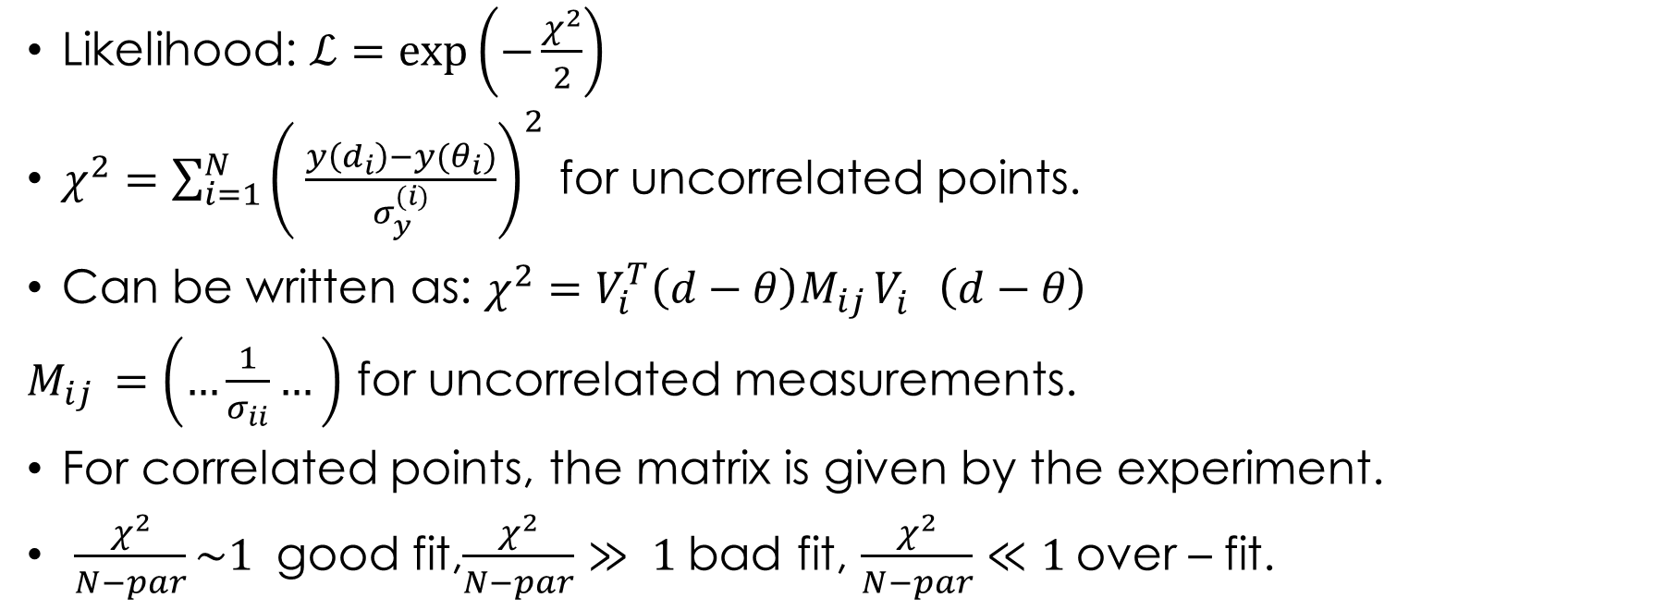
Bayesian Analysis
Likelihood: $ℒ=\exp\left(−\frac{χ^{2}}{2}\right)$
$χ^{2}=\sum_{i=1}^{N}{{\left( \frac{y\left(d_{i}\right)−y(θ_{i})}{σ_{y}^{(i)}}\right)}^{2}}$ for uncorrelated points.
Can be written as: $χ^{2}=V_{i}^{T}\left(d−θ\right)M_{ij }V_{i}^{}\left(d−θ\right)$
$M_{ij }=\left(…\frac{1}{σ_{ii}}…\right)$ for uncorrelated measurements.
For correlated points, the matrix is given by the experiment.
$\frac{χ^{2}}{N−par}\sim 1$ good fit,$\frac{χ^{2}}{N−par}≫ 1$bad fit, $\frac{χ^{2}}{N−par}≪1$over – fit.

Slide 4
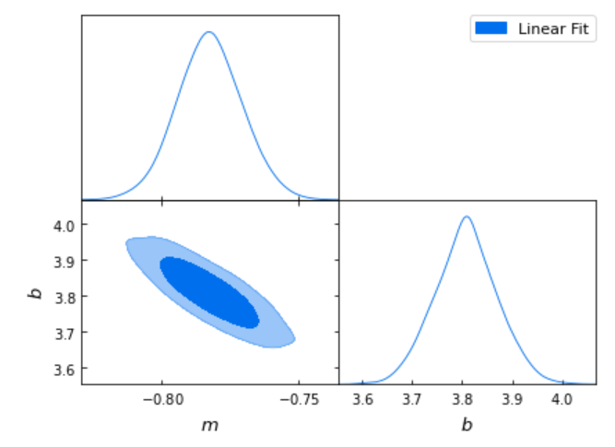
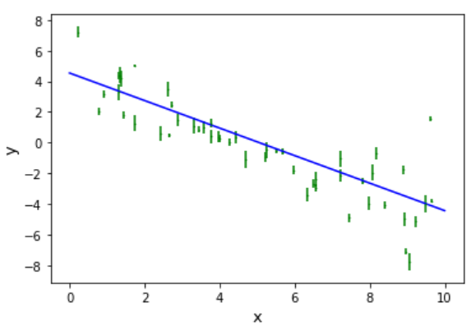
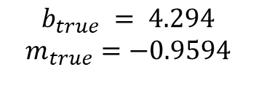


Simple example
samplers-demo/pages/samplers-samplers-everywhere/
$$b_{true} = 4.294$$
$$m_{true}=−0.9594$$
$$m=−0.898±0.023$$
$$b=4.54±0.13$$

Slide 5

Model comparison
Akaike Information Criterion (AIC) (Schwarz 1978)):
$$AIC =χ_{min}^{2} + 2p$$
Bayesian Information Criterion (BIC) (Liddle 2004, Akaike 1974):
$$BIC =χ_{min}^{2} + 2p\log{N}$$

